Slide 1


SIMATS ENGINEERING
SAVEETHA INSTITUTE OF MEDICAL AND TECHNICAL SCIENCES
Reverse Engineering and Architecture Reconstruction of an AI-Based Intelligent System
CSA1709 – Artificial Intelligence
P POORNA CHANDU(192412199)

Slide 2
INTRODUCTION
Reverse engineering is analyzing an existing system without its original design documents, to recover its architecture, components, and logic.
It's a key skill in software maintenance, security auditing, and AI-system evaluation.
The system studied here is a 16-program Python/Prolog codebase covering search, game-play, CSP, and logical inference — built with no shared design spec.
The analysis proceeds in 5 stages: System Analysis → Architecture Reconstruction → Logic Identification → Data-Flow Mapping → Redesign Proposal.
Together, these stages take the system from black-box observation to a concrete redesign proposal.

Slide 3
System Analysis
User Interface: Accepts input from the user through web or mobile applications.
API Gateway: Handles authentication, request routing, and communication.
Application Layer: Processes requests and manages sessions and context.
AI/ML Engine: Performs preprocessing, feature extraction, model inference, and decision-making.
Data Layer: Stores datasets, trained models, knowledge, logs, and system outputs.
Response Generator: Converts the processed result into a suitable response for the user.

Slide 4
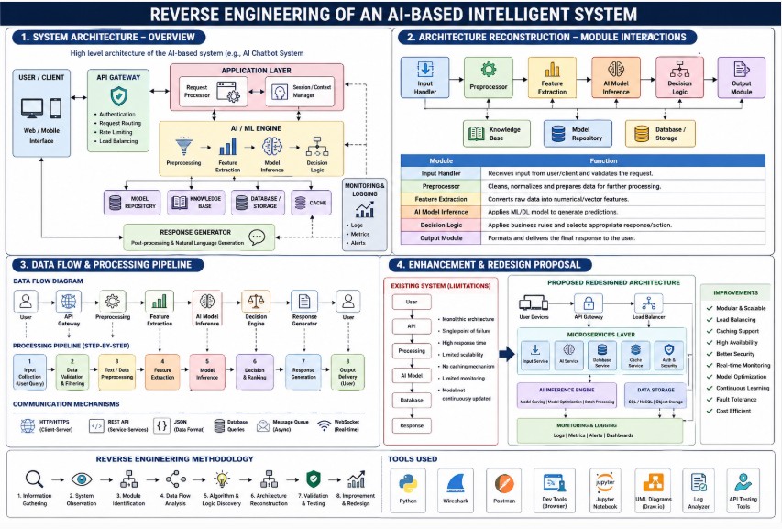
System Architecture

Slide 5
Major Modules
Transaction Data Acquisition
Distributed Data Processing
Feature Engineering
Fraud Detection
Alert and Reporting
Algorithm & Logic Identification
RDD transformations
RDD actions
Map and Reduce operations
Feature extraction
Classification logic
Fraud probability/threshold-based decision making

Slide 6
Communication Mechanisms
Driver coordinates the application.
Executors process data in parallel.
RDDs distribute datasets across worker nodes.
Spark communicates tasks between driver and executors.
Distributed storage provides scalable data access.
Enhancement & Redesign
Introduce real-time transaction processing.
Use optimized Spark transformations.
Add advanced ML models.
Implement continuous fraud monitoring.
Improve fault tolerance and scalability.

Slide 7
Conclusion
Reverse engineering helps understand the AI system architecture.
It identifies the main components and modules.
It explains the data flow and processing steps.
It helps identify the algorithms and decision logic.
It supports system improvement, debugging, and optimization.

Slide 8
THANK YOU

